Slide 1

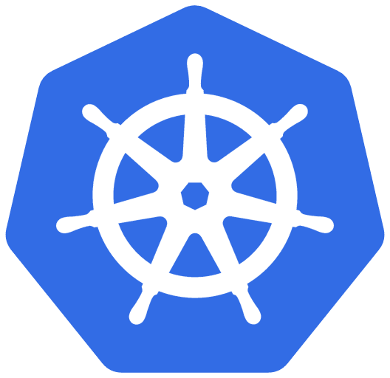
Running .NET Aspire on a local Kubernetes Cluster
Jorge Arteiro
Cloud Native Developer Advocate at Microsoft
@JorgeArteiro
@AzureTar

Slide 2
Local Kubernetes vs AKS - Azure Kubernetes Services
My Local Dev Environment & Tools
Demo – Create local Kind cluster
Agenda
Demo – Generating Kubernetes Manifests
Demo – Deploying to your local cluster
Demo – Debugging using local Kind Cluster and Mirrord
Bonus

Slide 3
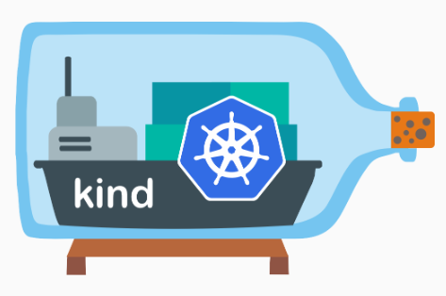




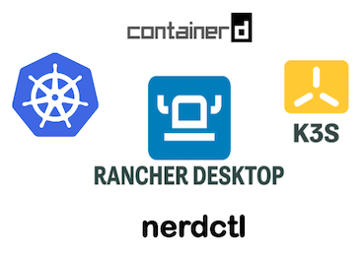
Local Kubernetes

Slide 4
Kubernetes Resources – Applying yaml manifests
namespace
deployment
pod
service
ReplicaSet
volumes
ingress
secret
config-map
StatefulSet
DaemonSet
jobs

Slide 5
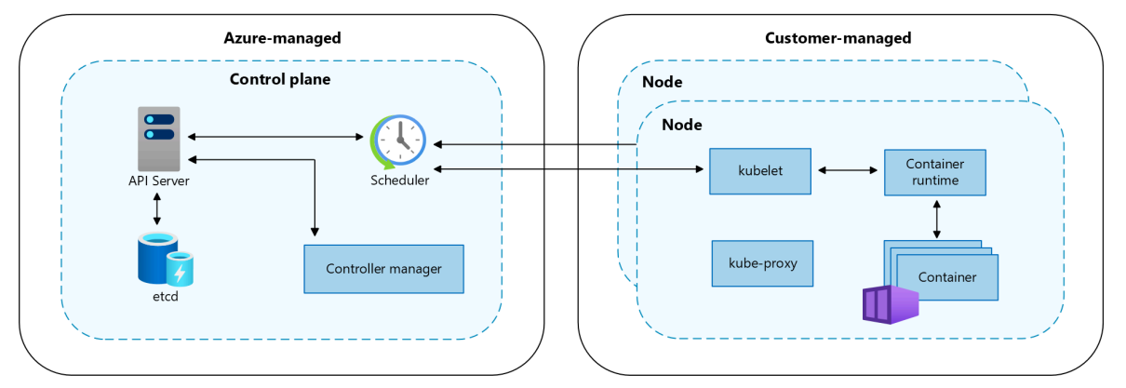
Kubernetes Cluster

Slide 6
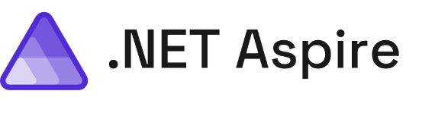
.NET Aspire Includes…
A cloud ready stack for building observable, production ready, distributed applications
Smart Defaults
Developer Dashboard
Orchestration
Service Discovery
Integrations
Deployment
Notes:
So what's in .NET Aspire? There's a series of different features that help developers be more productive, build better observable production ready distributed applications, and ease the deployment in many scenarios for us. We're going to take a look at every single one of these different features from start to finish and integrate them into our application. Now a lot of people start with the developer dashboard because it's the fancy shiny thing that ships directly with .NET Aspire but we're going to start in a different area first which I think is one of the areas and features that every single application should integrate into our application today

Slide 7
Demos
Demo1 – Create local Kind cluster
Demo2 – Generating Kubernetes Manifests
Demo3 – Deploying to your local cluster
Demo4 – Debugging using local Kind Cluster and Mirrord
Clone
Github.com/jorgearteiro/movie-store

Slide 8
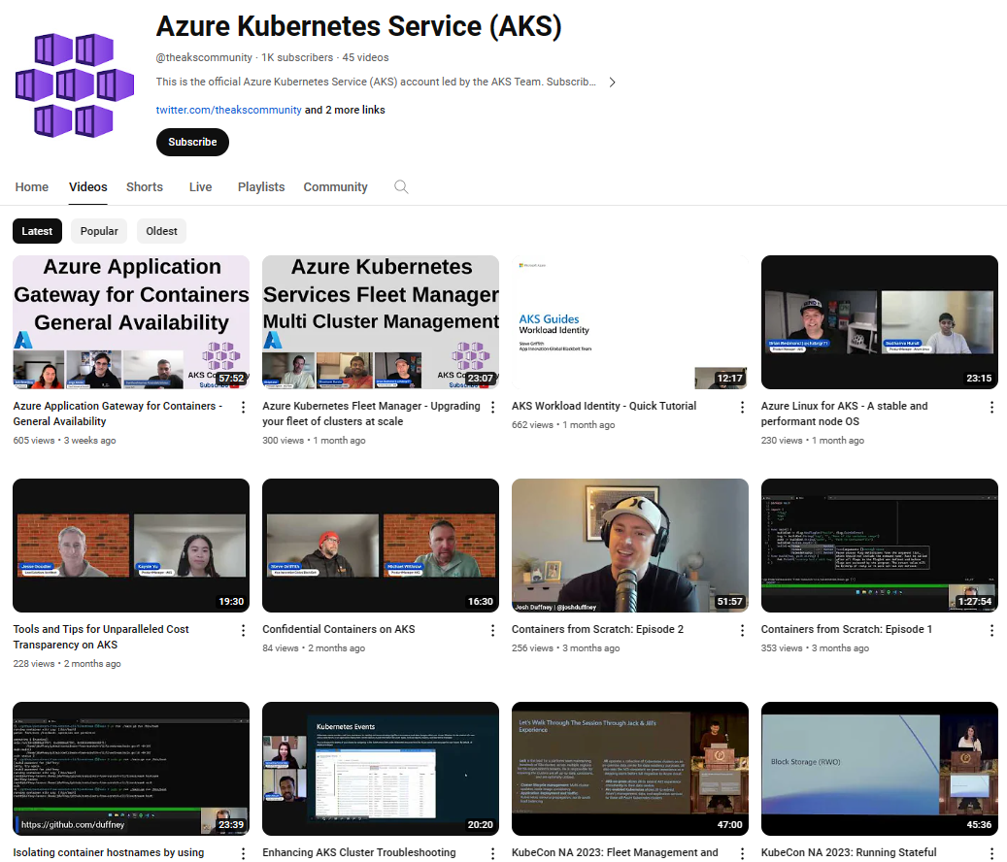

@theakscommunity
youtube.com/AzureTar
Be sure to subscribe!
https://www.youtube.com/@theakscommunity

Slide 9

Get .NET 9
Download .NET 9 aka.ms/get-dotnet-9

Slide 10
Resources
aka.ms/letslearn/dotnet/aspire
aka.ms/aspire/videos
Aspire Learning Resources
.NET Aspire Videos
aka.ms/dotnet-aspire
Github.com/dotnet/aspire
Documentation
GitHub
aka.ms/adopt/containers
aka.ms/K8sonAzure
Container Adoption Best Practices
Kubernetes on Azure
aka.ms/LearnKubernetes
aka.ms/k8sLearning
Learning Path
What is Kubernetes

Slide 11
Thank you

